Slide 2
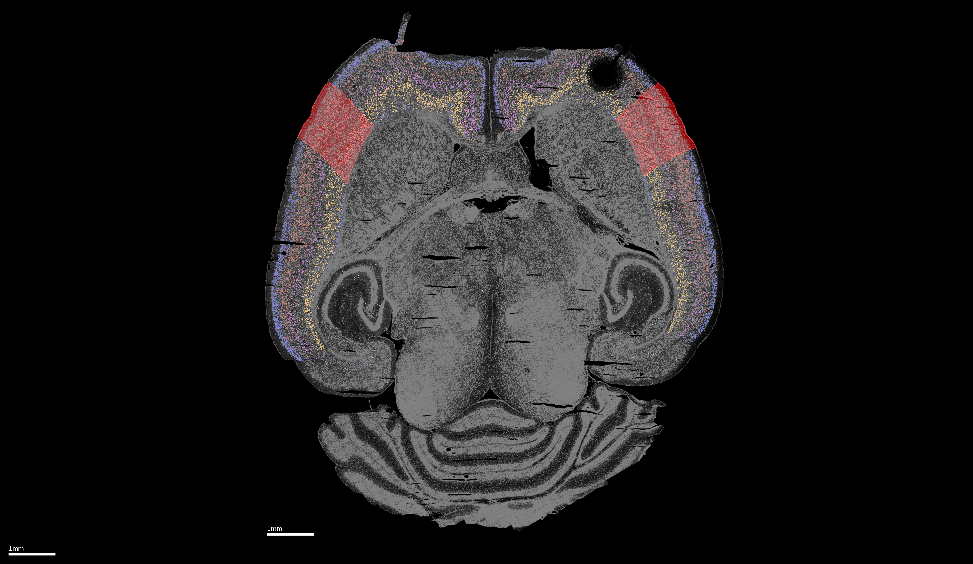
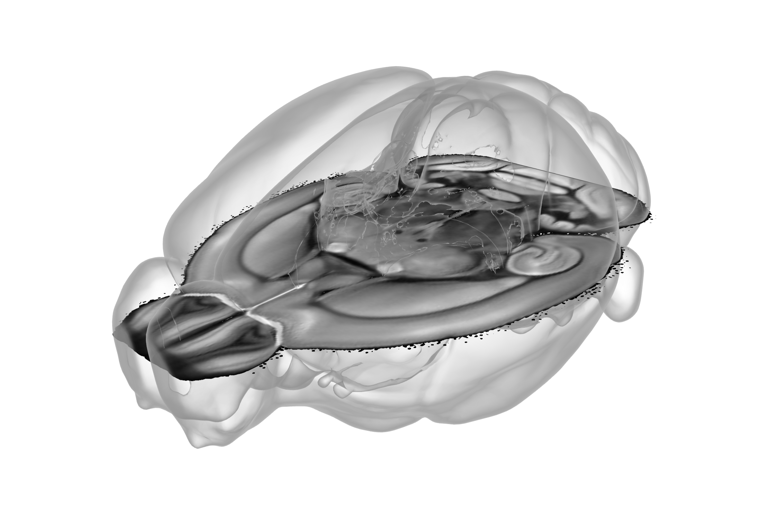
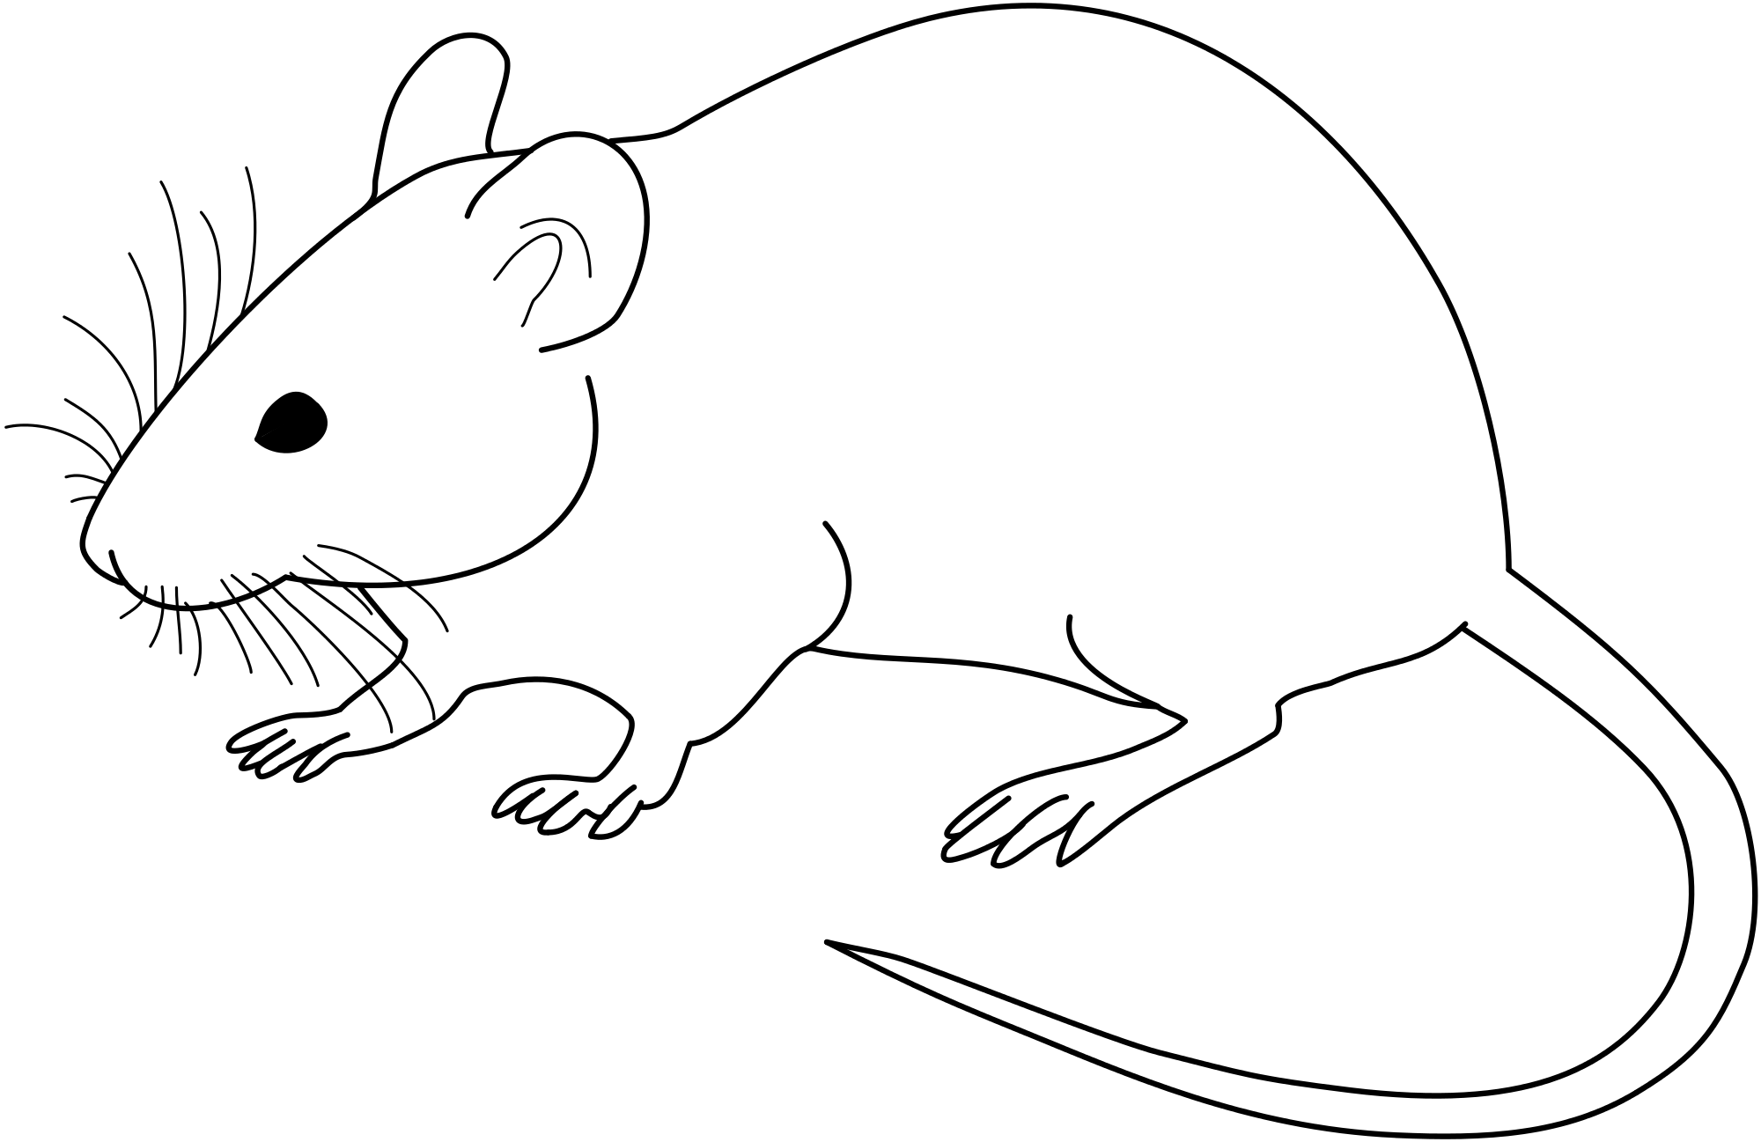
*Allen brain atlas

Slide 3
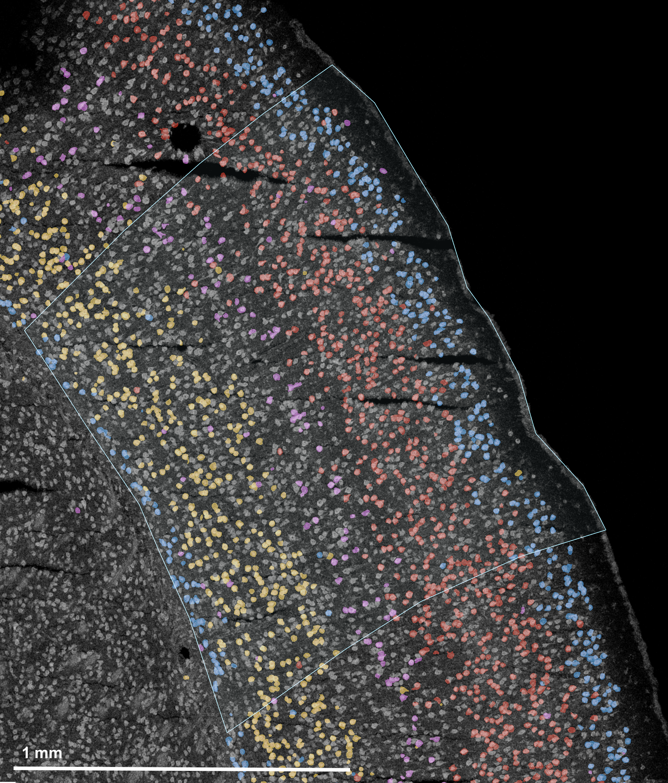
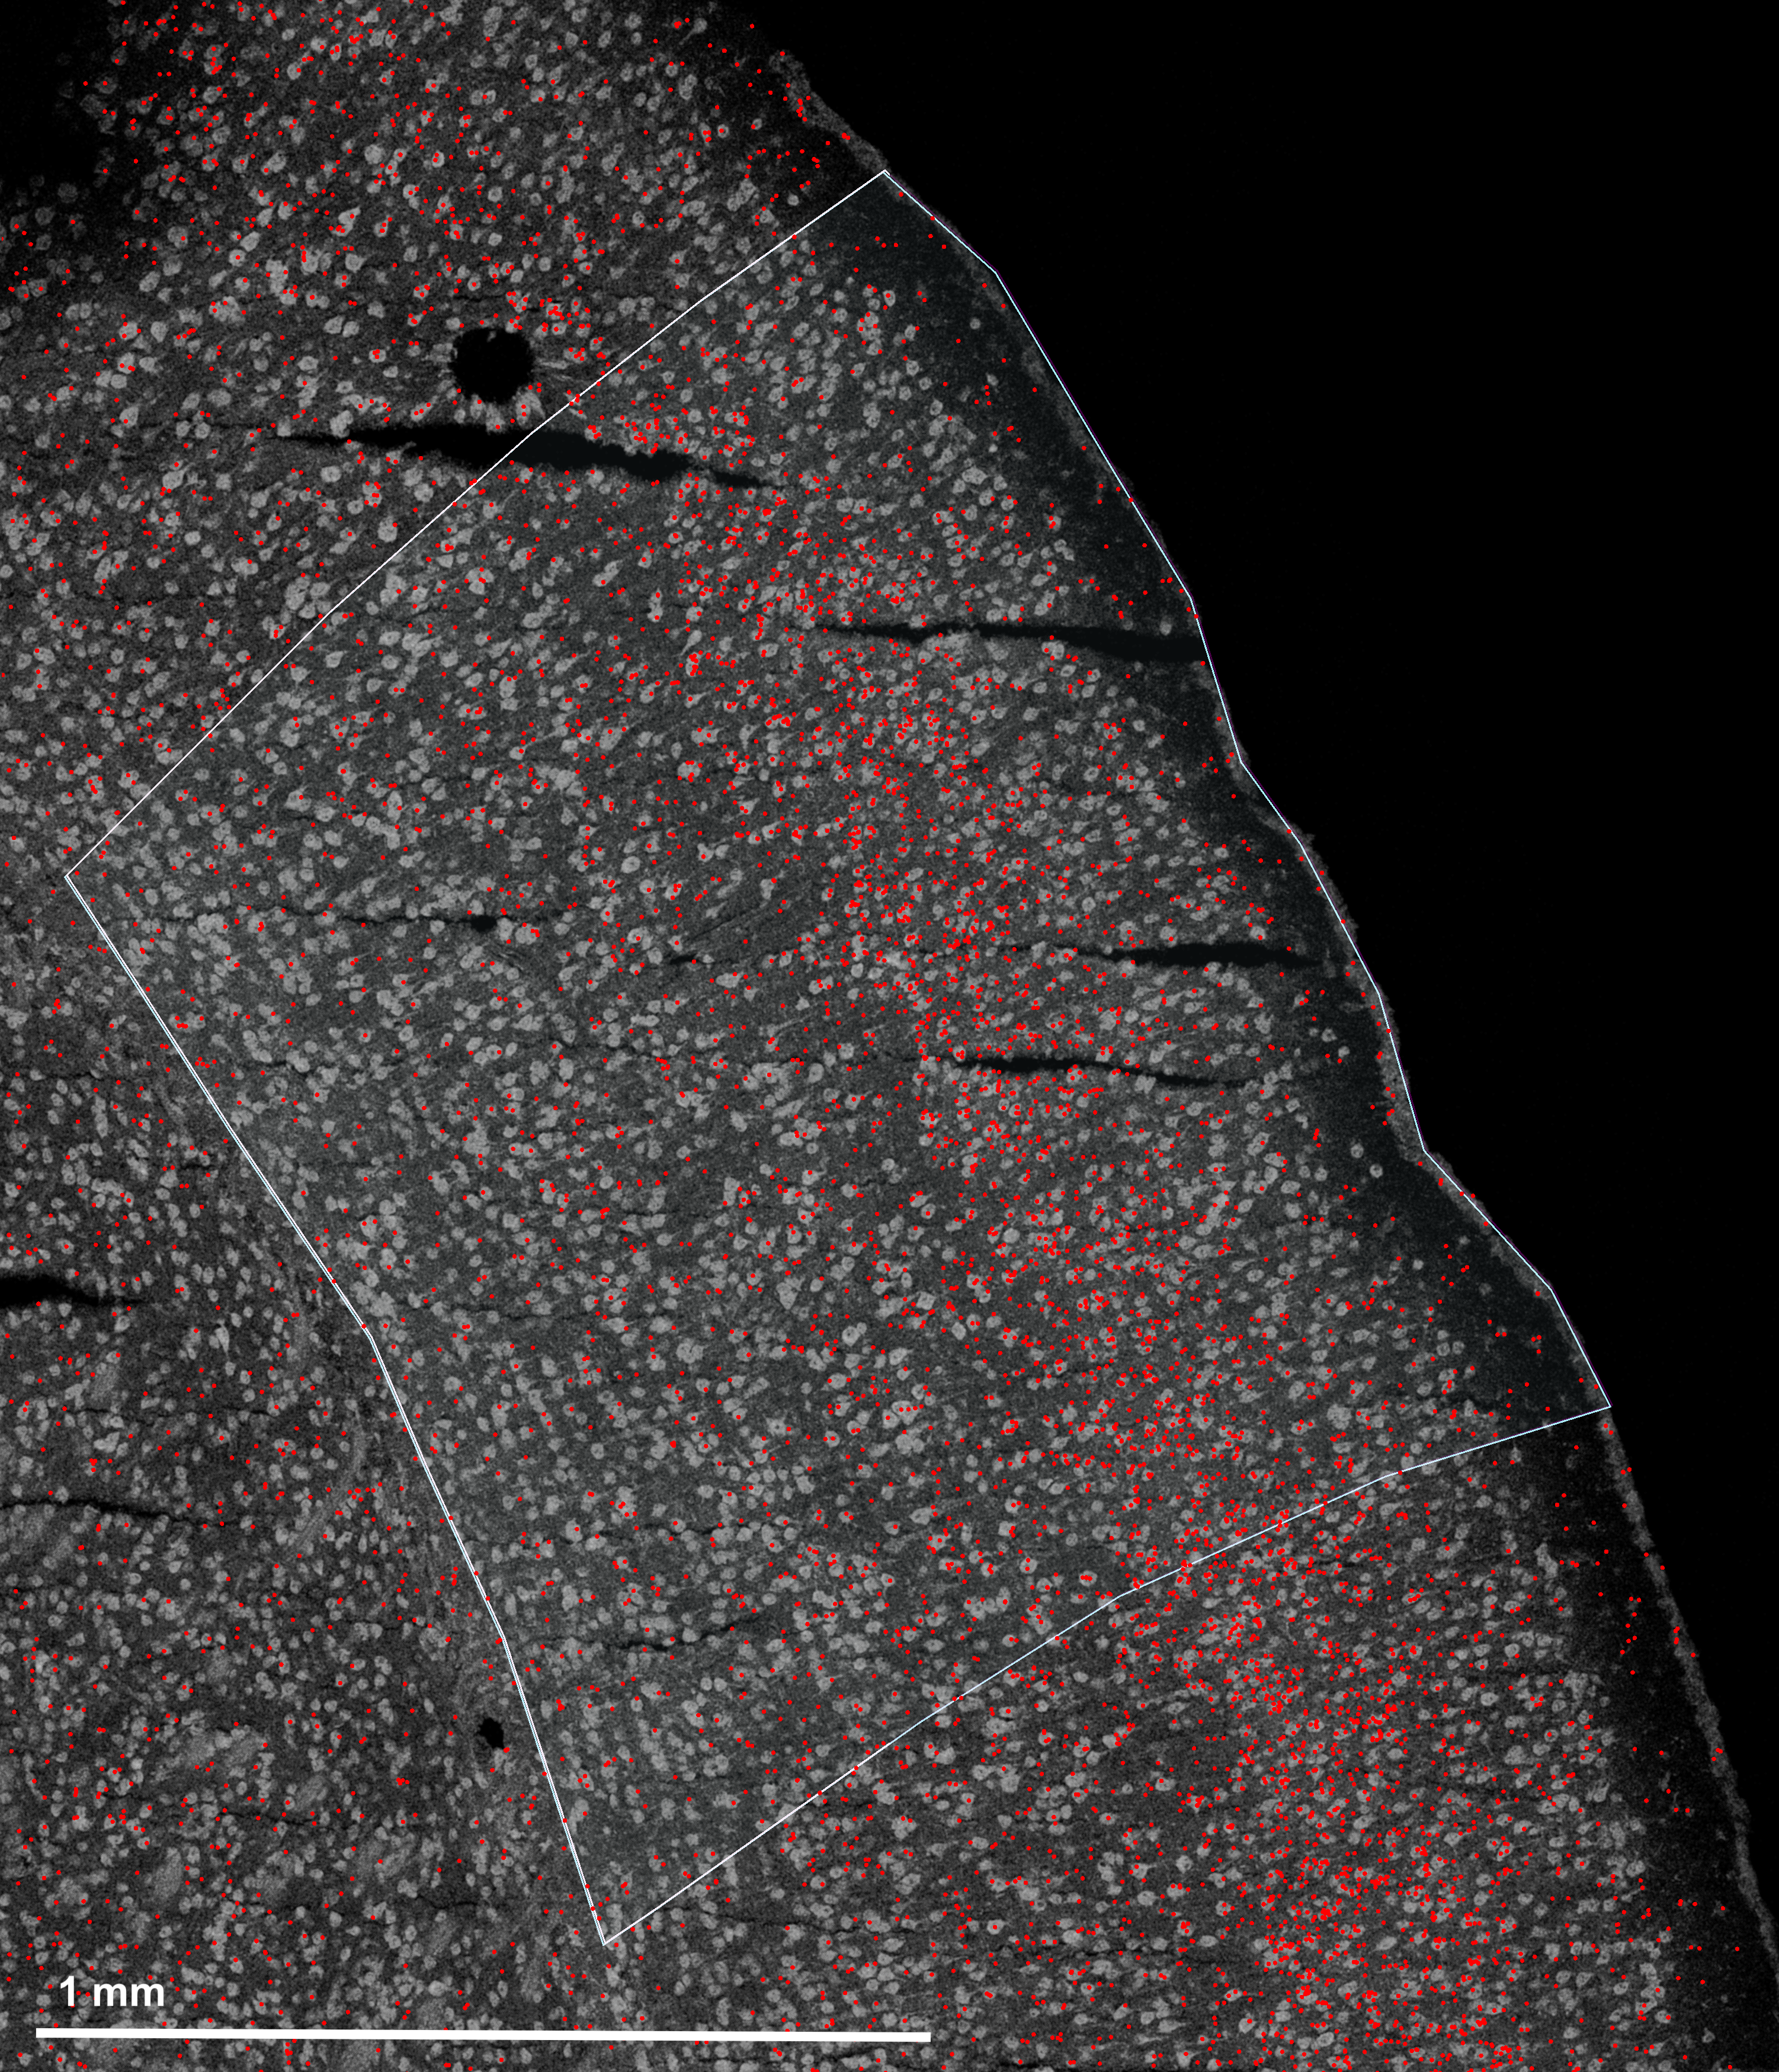
laminar axis
columnar axis
L1
L4
L2/3
L5
L6a
L6b

Slide 4
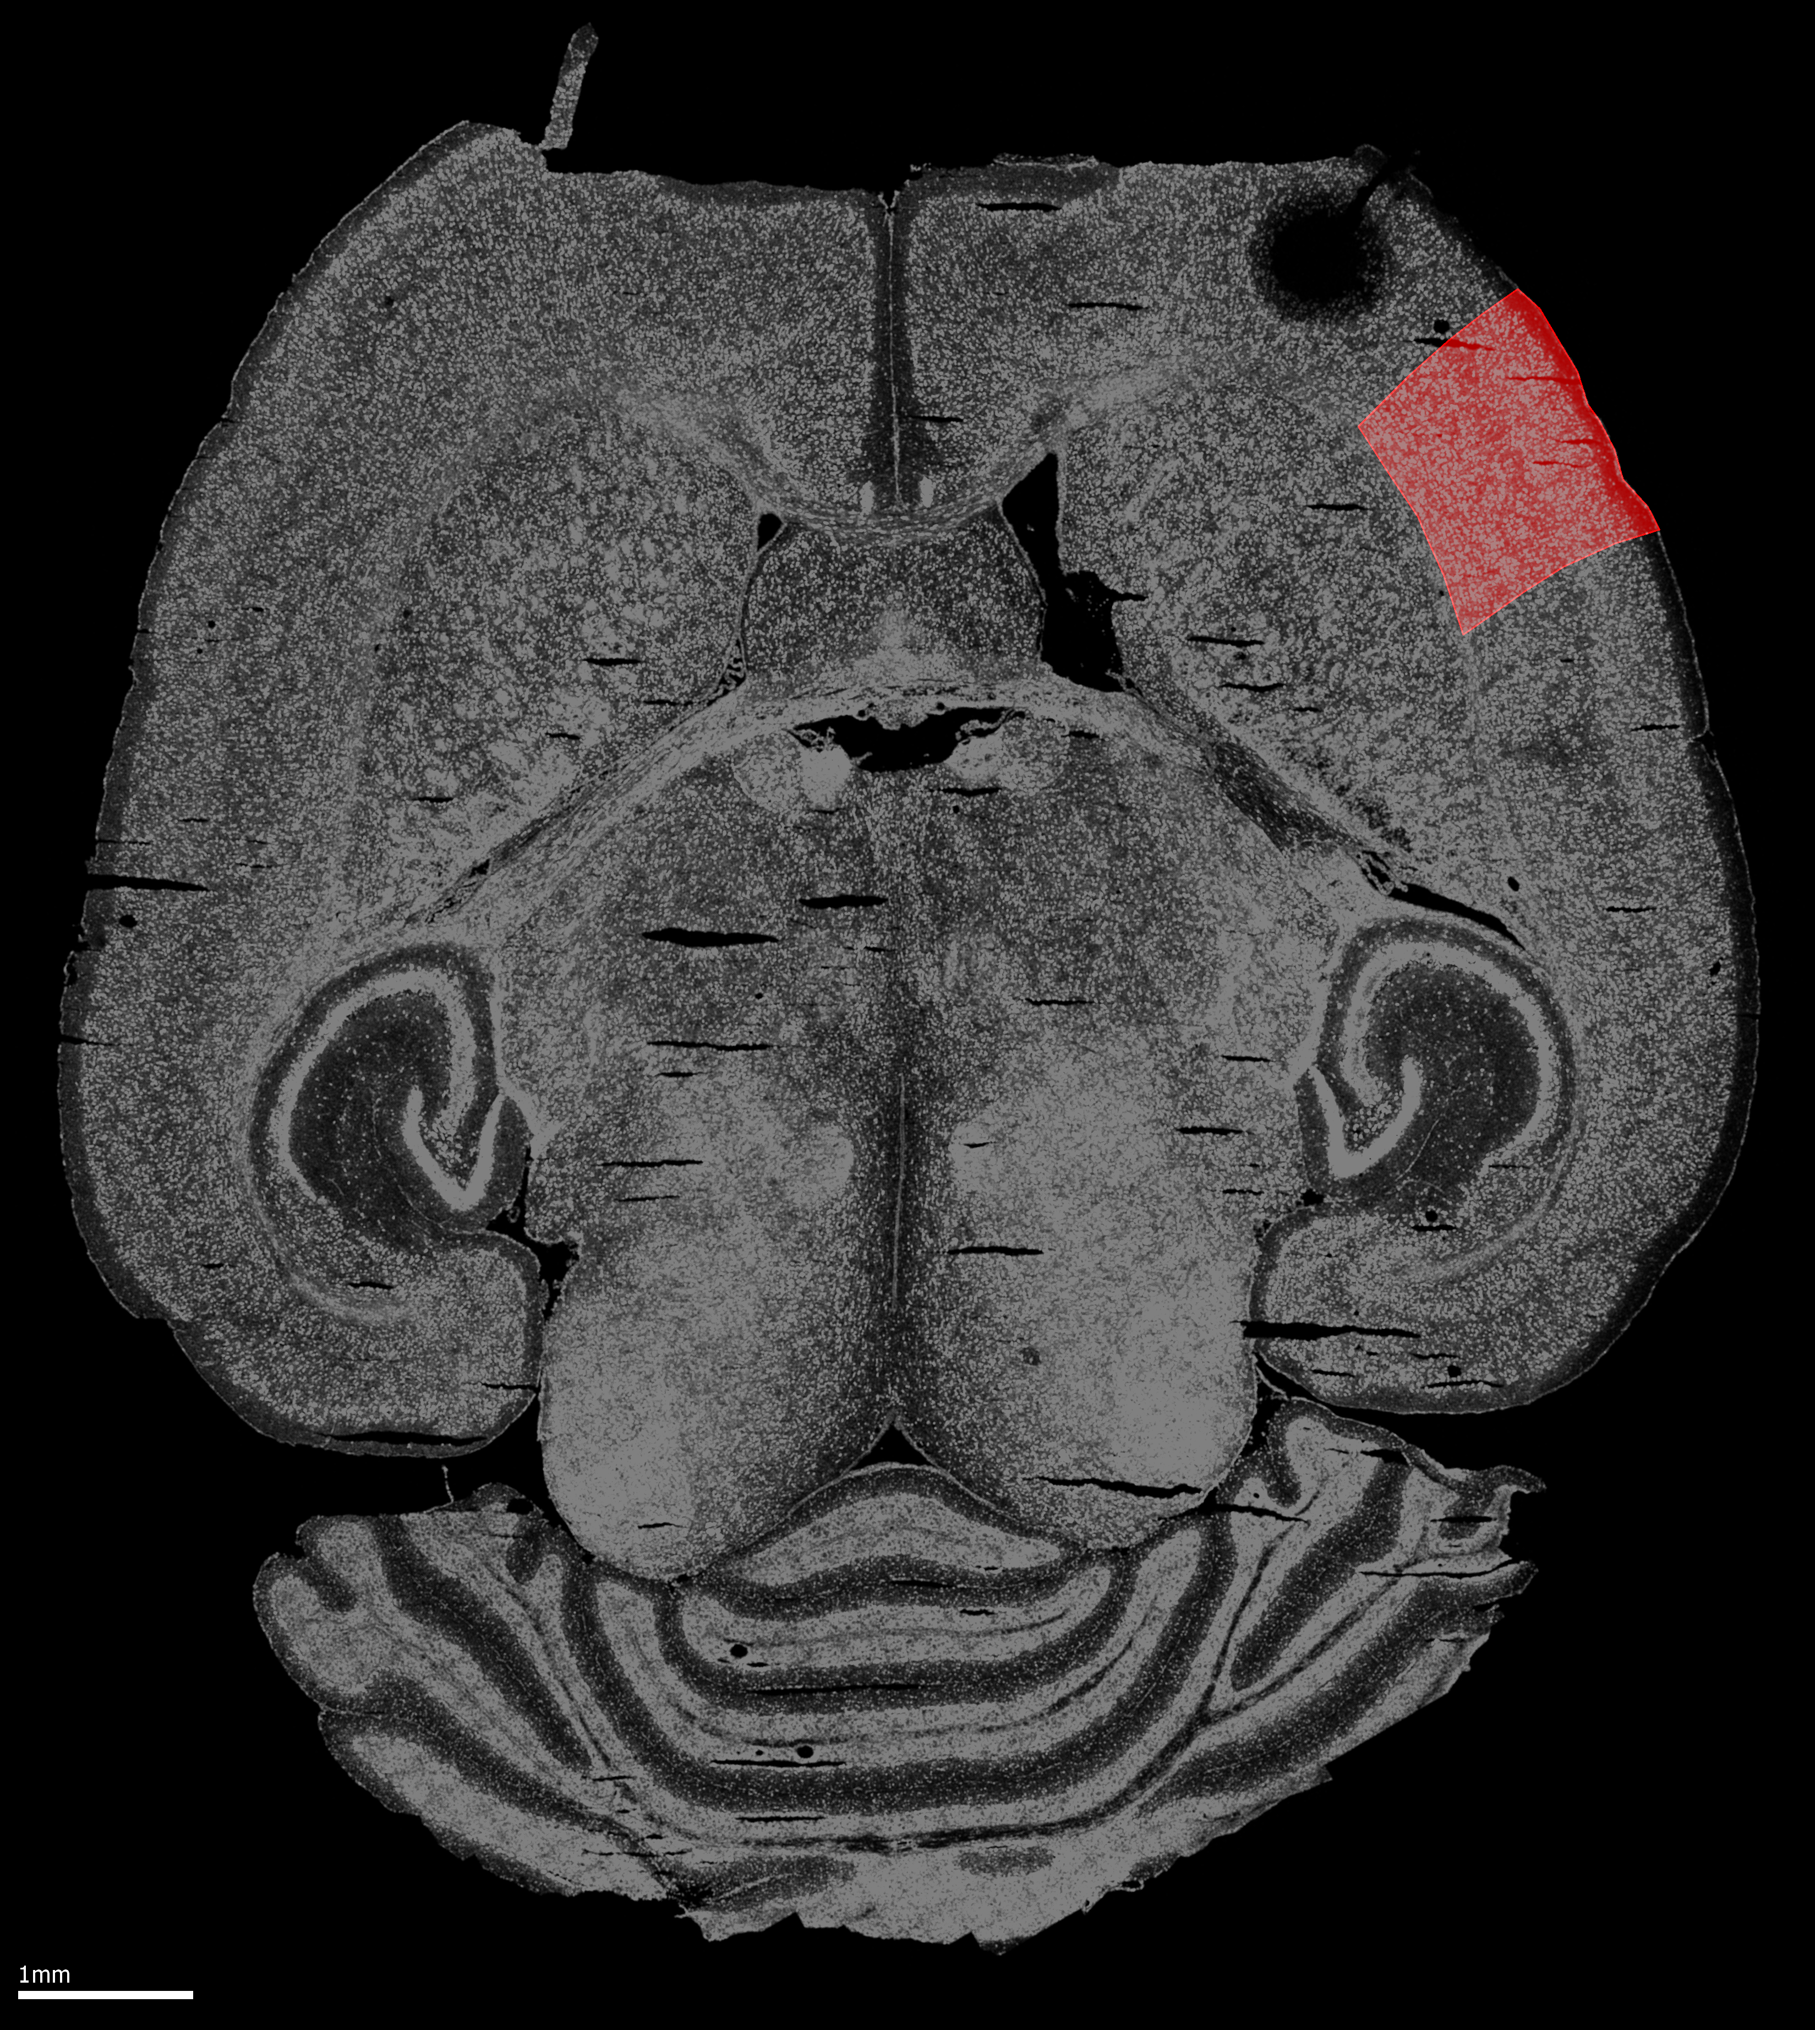
L1
L2/3
L4
L5
L6a
L6b
Columnar
Axis
Laminar
Axis

